Slide 1
Marine Reptiles

Slide 2
Reptiles
First to move to land
Then some came back to water
4 orders:
  Snakes & Lizards
  Crocodiles, etc
  Tuataras
  Turtles and tortoises

Slide 3
Reptiles
Adapated to life on land:
  Lungs
  Skin--hard, prevents dessication, some have slimy coating
Aquatic ones hve legs/flippers for swimming
Are ectothermic
Lay eggs
  Return to land to breed
  except a few (mainly in cold areas--why?)
Larva look like miniature adults

Slide 4
Sea Snakes
55 species
In tropical Indian and Pacific Oceans
Flat body, tail like a paddle
1-1.3 meters long
ovoviviparous: young start out in eggs in mom then she gives birth to live young
carnivorous→ eat fish, roe, etc
Venomous--can be fatal to humans
small mouth and not very aggressive
hunted for skins

Slide 5
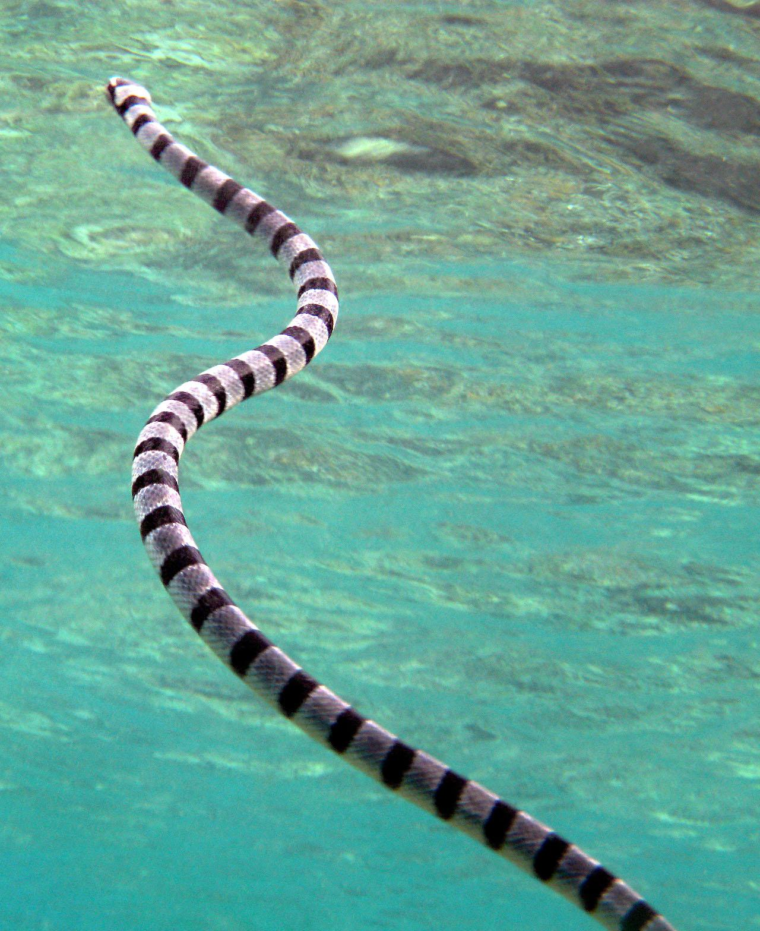
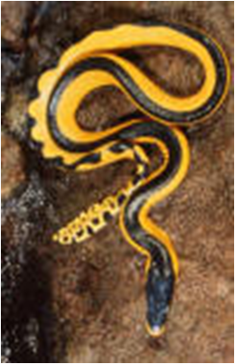
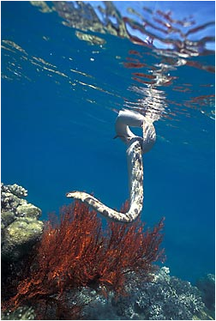

Slide 6
Marine Iguanas
Live on Galapagos Islands
Basks in sun a lot
Eats seaweed and algae
Population numbers decreased w/ last El Nino b/c algae was killed with warmer waters=no food, so iguanas died :(

Slide 7
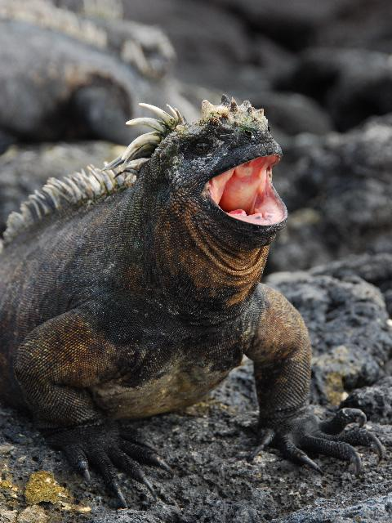
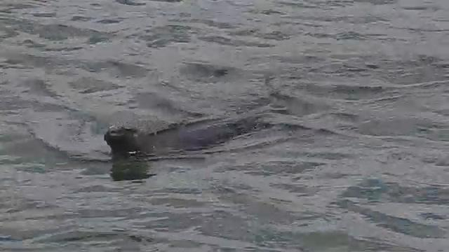

Slide 8
Saltwater Crocodile
Crocodylus porosus
Live in mangrove swamps and estuaries--Indian Ocean, Australia and some W. Pacific Islands
Live along the coast
10m= longest, average is about 6m
most aggressive of all marine animals-- said to attack and eat people

Slide 9
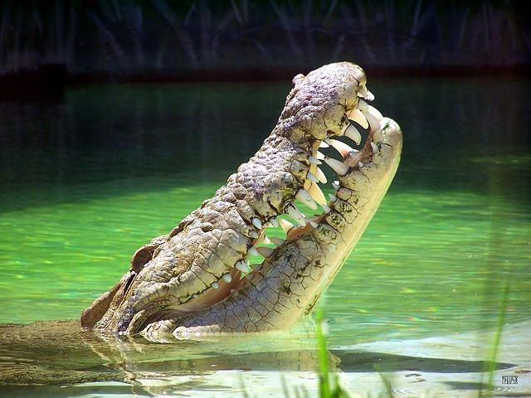

Slide 10
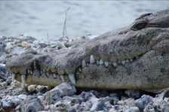
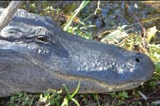
Alligators vs. Crocodiles
Alligators have a wider, rounder mouth
When jaw is closed only upper teeth exposed on an alligator while upper and lower can be seen on a crocodile (particularly the 4th lower tooth)

Slide 11
Tuatara
Looks like a lizard but isn’t--its skeleton suggests it is the last of an ancient group of reptiles
Only found in New Zealand
Has a 3rd eye, just light sensitive, under the skin
Development is s l o w
  eggs in mom for 10 months
  eggs hatch after another year
  not sexually mature until 20 years old!
Slow metabolism
Why might all this slowness make them more vulnerable?

Slide 12
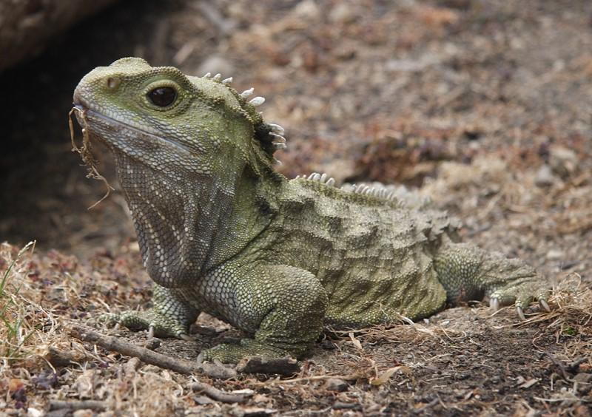

Slide 13
Sea Turtles
Herbivores
Flippers rather than legs
Can hold their breath for long periods of time to dive (but are air-breathing)
Most sea turtles are endangered

Slide 14
Sea Turtle Reproduction
Females return to their natal beach (beach where they hatched) to lay approximately 100 eggs in a shallow nest
Sex of the eggs is determined by temperature
Eggs hatch after approx 50-70 days
Only 1-2 hatchlings will survive to adulthood

Slide 15
