Slide 1
Marine Mammals

Slide 2
General Info
Evolved from reptiles
Now ~4500 species
Endothermic (Warm-blooded)
Skin has hair
Very large brain, very complex
Adaptable, can live anywhere there is air to breathe and food to eat

Slide 3
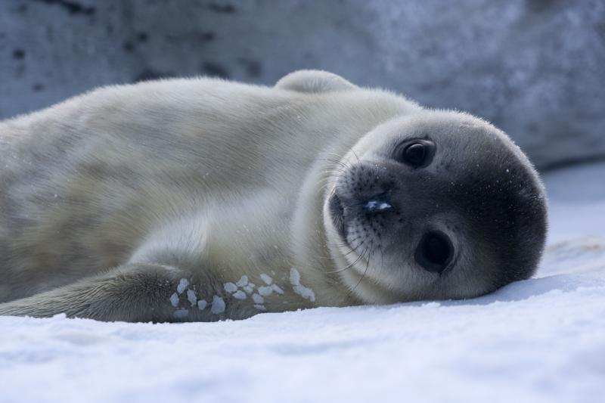
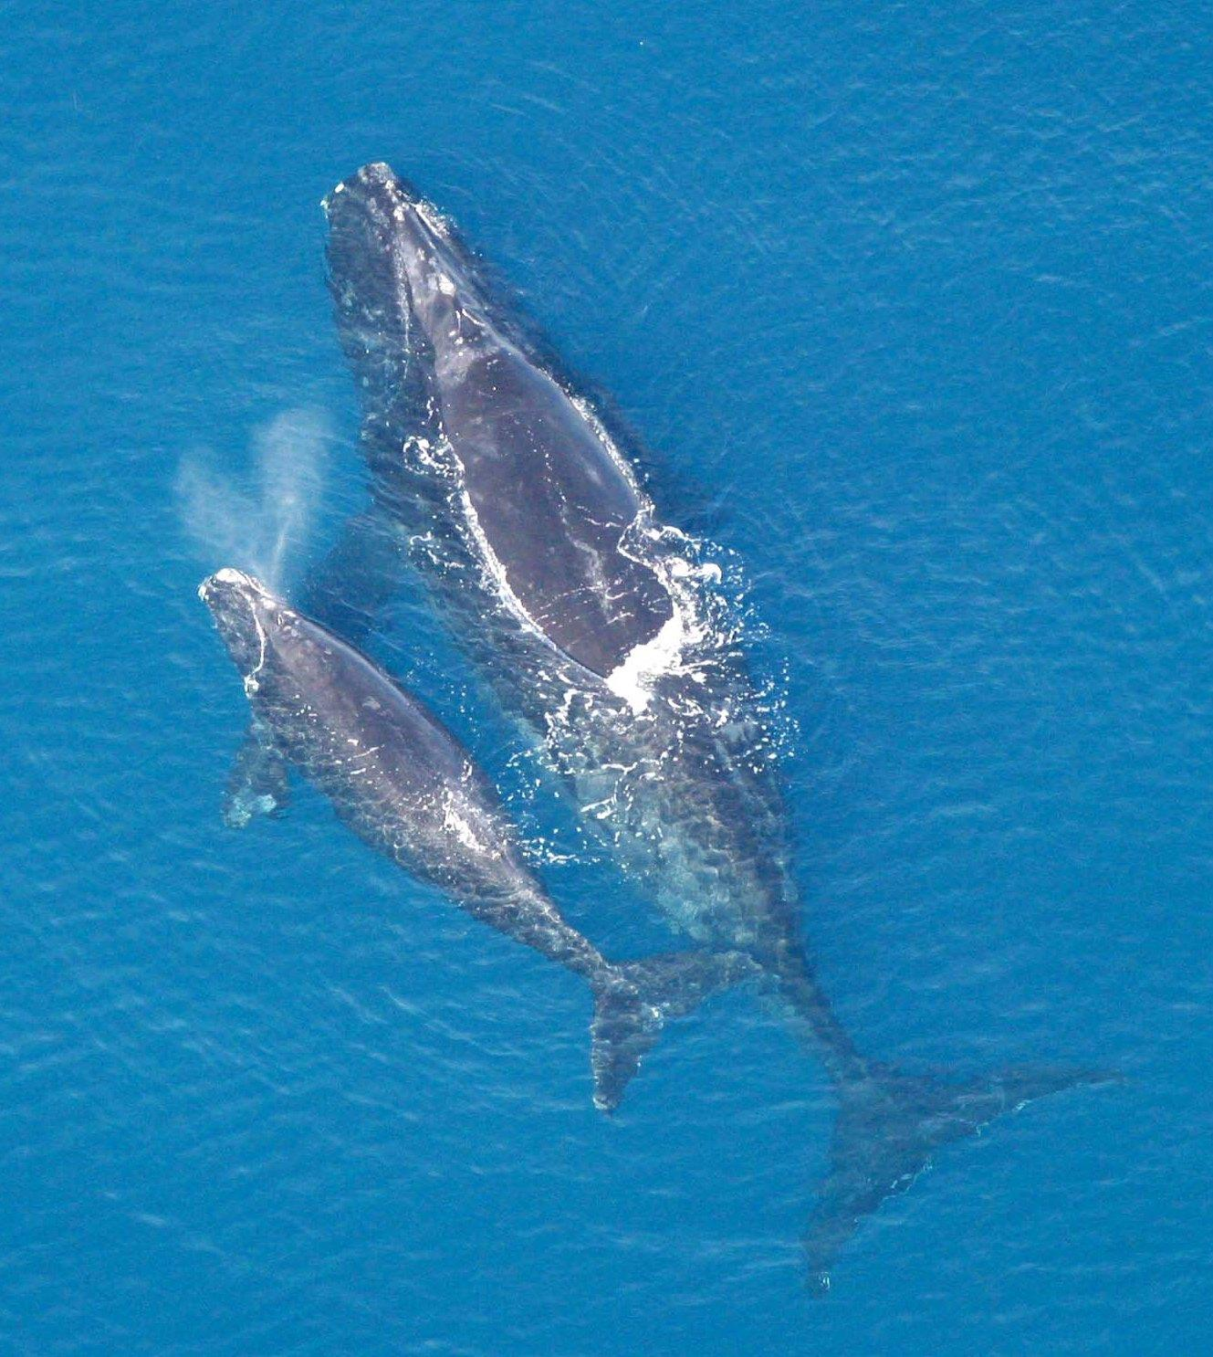
General Info
Most are viviparous (give birth to live young)
Nurse young with mammary glands
Produce few young because it “costs” a lot to raise them

Slide 4
Pinnipeds-seals, sea lions, walruses
Evolved from terrestrial carnivores
Have paddle-shaped flippers
Rest & breed on land
Predatory
Streamlined bodies
Live in cold water→ blubber
Bristly hair
Usually larger animals

Slide 5
Seals
19 different seal species
B/c of their rear flippers cannot move forward and must use a “flopping” motion to move on land
Do not have “ears” but can hear
Can hold their breath for up to 15 minutes to dive deep

Slide 6
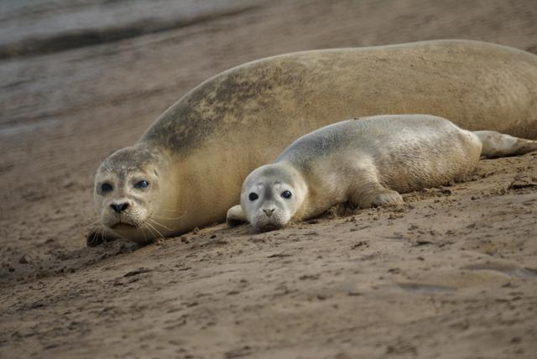
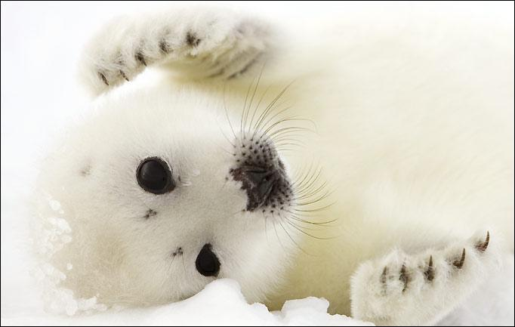
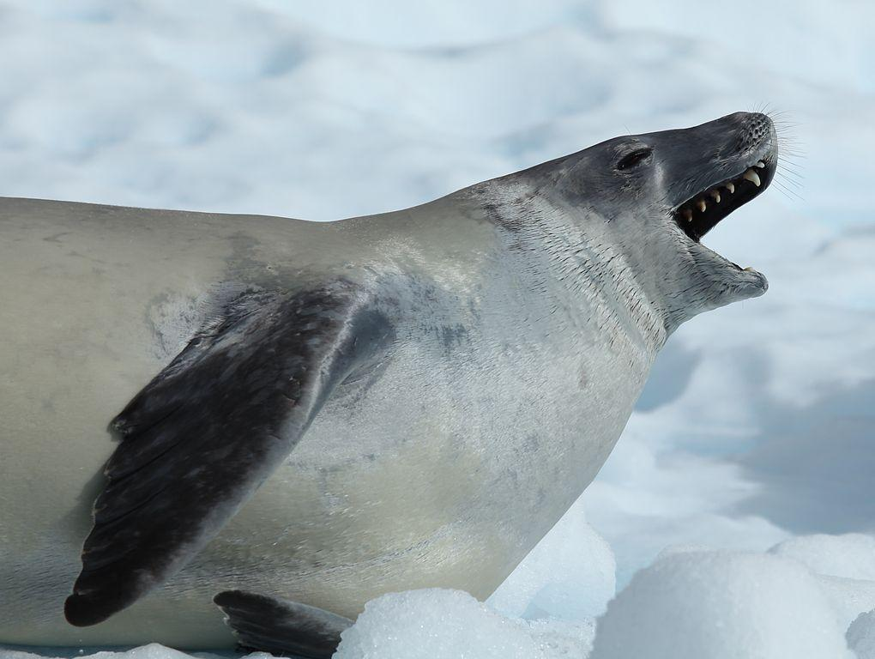
Seals
Some were hunted for skin/fur, meat, and oil.
  Almost hunted to extinction
The Marine Mammal Protection Act of 1972 has allowed their numbers to bounce back some

Slide 7
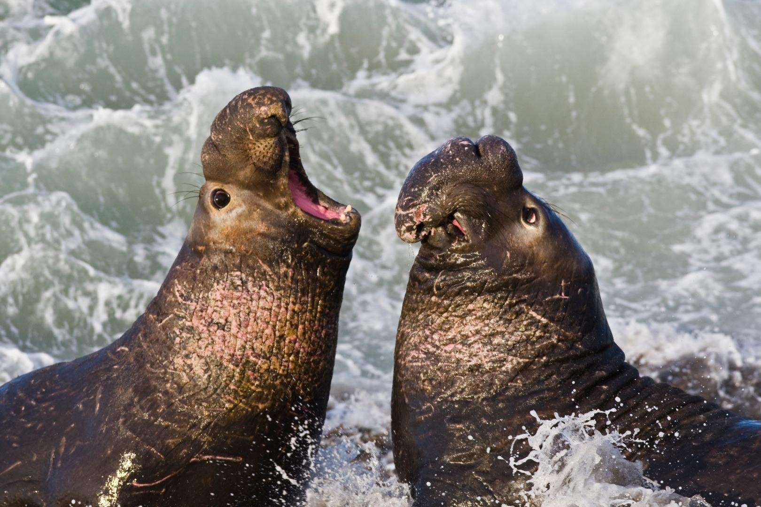
Elephant Seals
Males form harems
Males establish dominance by slashing each other’s thick necks until one tires and give up.
The “winning” male may crush the “loser” male’s pups...males can weigh up to 5000 lbs

Slide 8
Sea Lions
AKA the eared seals
Can run on land b/c they can move rear flippers forward
Can move front flipper back to prop themselves up
Males have a massive head w/ a hairy mane (this is why they are called sea “lions”)

Slide 9
Sea Lions
7 different sea lion species
Males are called bulls and females are cows
Instinctively close their nostrils together when diving in the water
Can remain underwater for up to 40 minutes

Slide 10
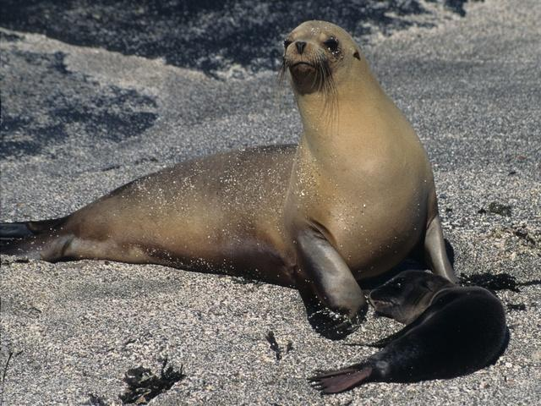
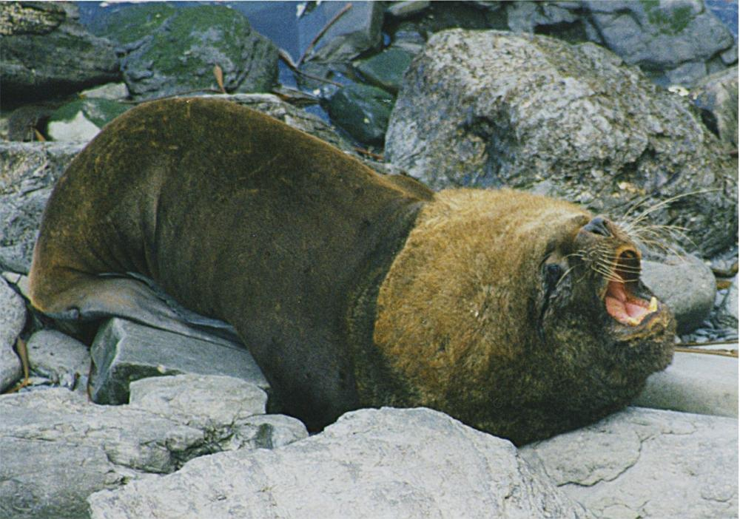
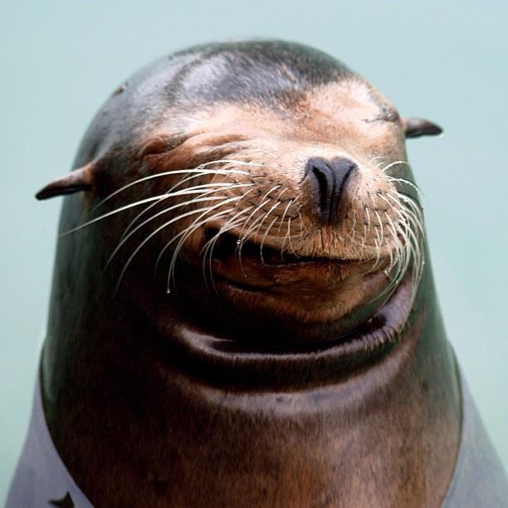

Slide 11
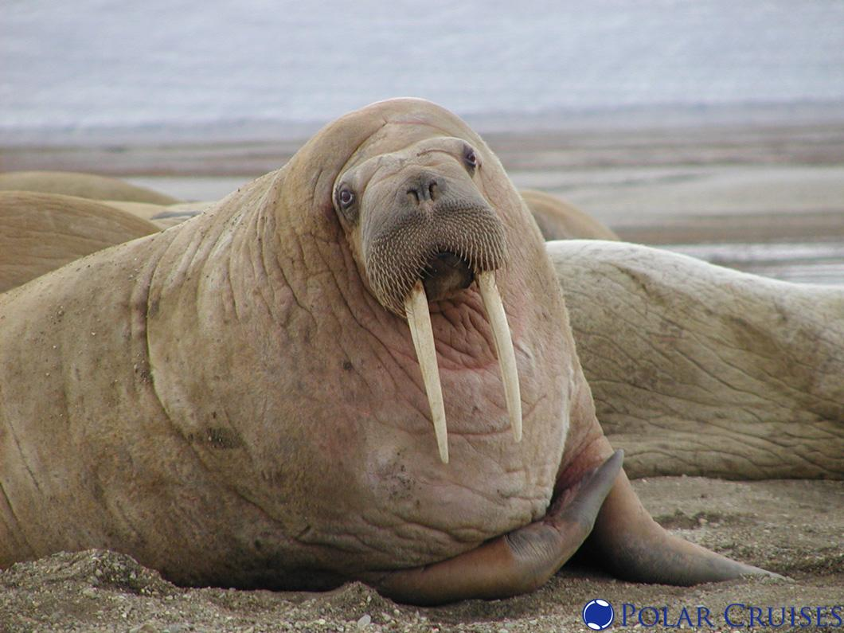
Walrus
Tusks protrude down from mouth
Eats bottom invertebrates
Sucks up food as it goes along the bottom
Whiskers act as feelers

Slide 12
Sea Otter
Order Carnivora
Smallest marine animal weighing 25-35 kg
No blubber, instead is insulated from fur
Playful and intelligent; uses tools
Spends most of their time in water
Needs about 25% of its body weight in food per day so spends the majority of his/her time looking for food--this is needed to maintain warmth.

Slide 13
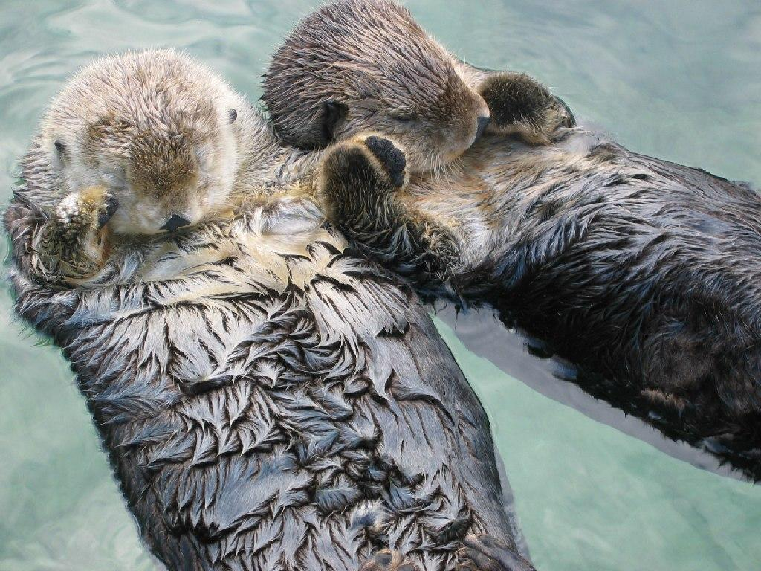
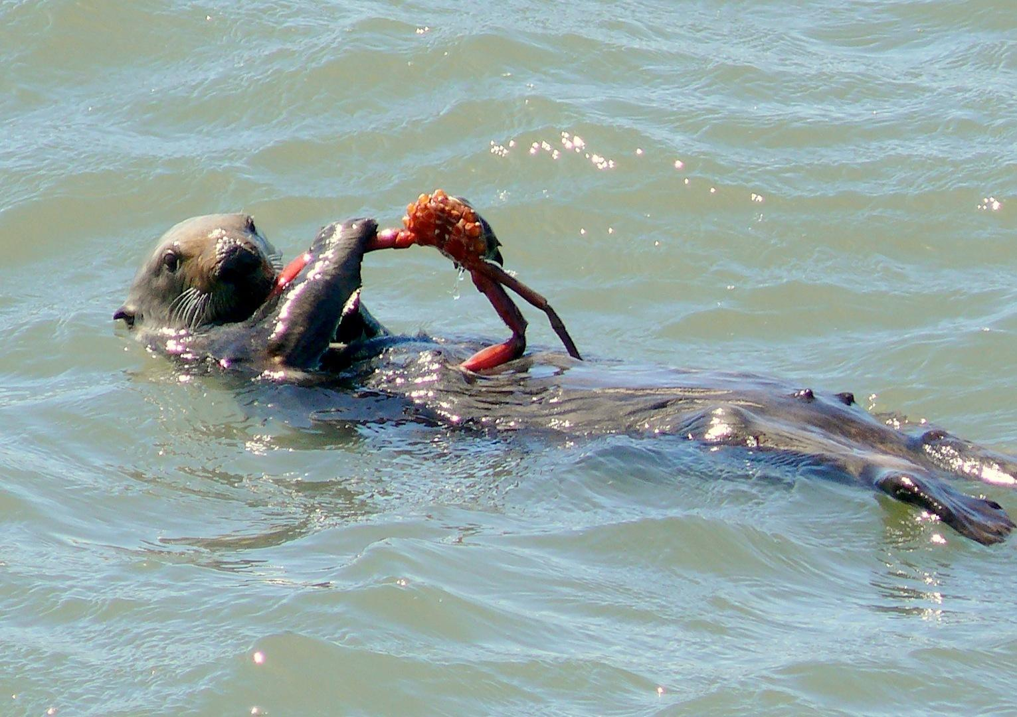
Sea Otter
Eat abalone, sea urchins, crabs, mussels, and other invertebrates--even fish
Live in or around kelp beds and help to keep them free of sea urchins (which eat plants)

Slide 14
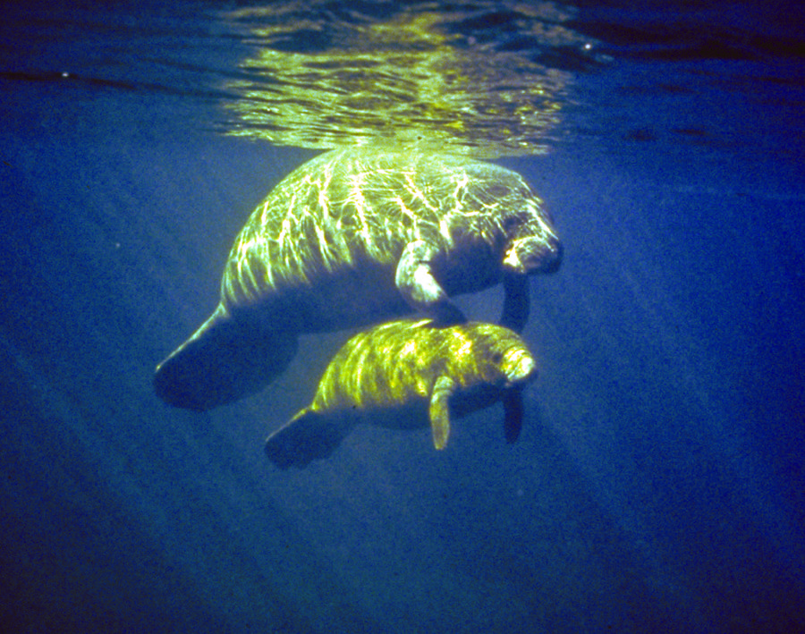
Sirenians: Manatees & Dugongs
Relatives of the elephant
Aka sea cows
front flippers only, no hind limbs
Lots of blubber
Wrinkled skin with a few hairs
Gentle & Peaceful

Slide 15
Manatees & Dugongs
Often live in groups
Vegetarians
  big lips for eating seaweed
All are big
  Manatees are about 4.5m and 600 kg
  Dugongs are about 3m and 420 kg
Reproduce slowly
All 4 species are endangered

Slide 16
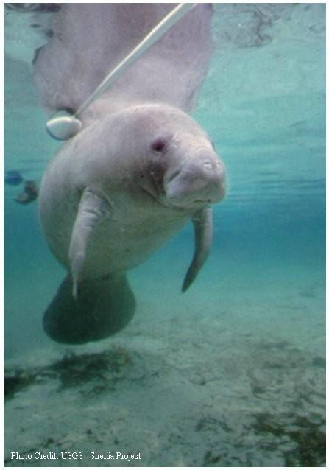
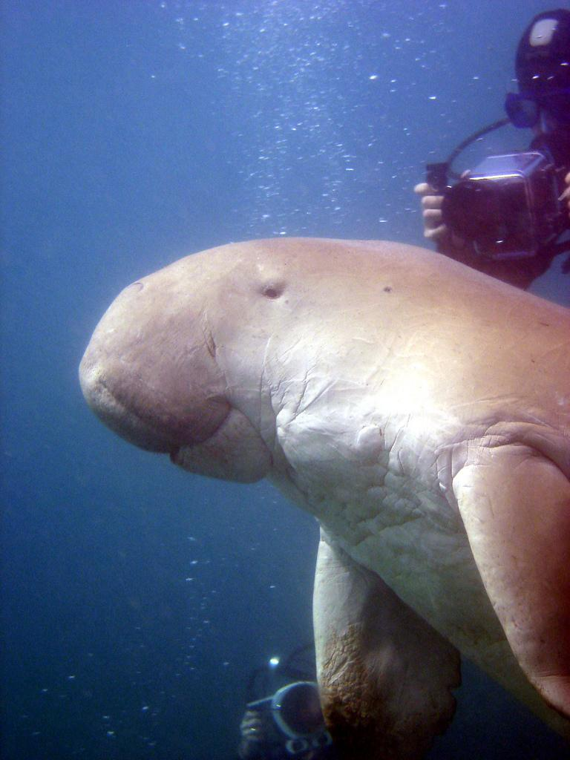

Slide 17
Whales, Dolphins & Porpoises
Order Cetacea (called Cetaceans)
Result of convergent evolution
  the process whereby organisms not closely related independently evolve similar traits as a result of having to adapt to similar environments
Breathe air (above water) and can drown
Warm-blooded, have hair and produce milk
Front flippers but no hind limbs
Tail ends in flukes (fin-like)

Slide 18
Whales, Dolphins & Porpoises
Blubber keeps them warm (very little hair)
Nostrils are fused and on top of head to form a blowhole
~90 species
Only 5 are freshwater (all dolphins)
2 groups:
  Toothless-filter feeding
  Toothed-carnivorous

Slide 19
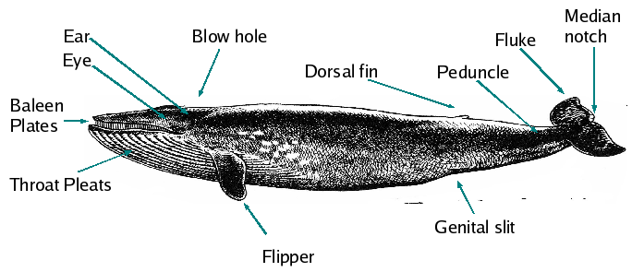
Label your whale
baleen
blowhole
dorsal fin
eye
flipper
fluke
rostrum
teeth
throat

Slide 20
Toothless Whales
Toothless whales are baleen whales
Baleen = rows of flexible, fibrous plates
Bristles overlap to form a dense “mat” on the roof of the mouth
Takes mouthfuls of water and squeezes it out through bristles
Then licks food left behind and swallows it

Slide 21
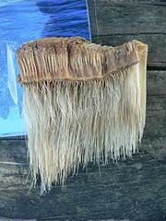
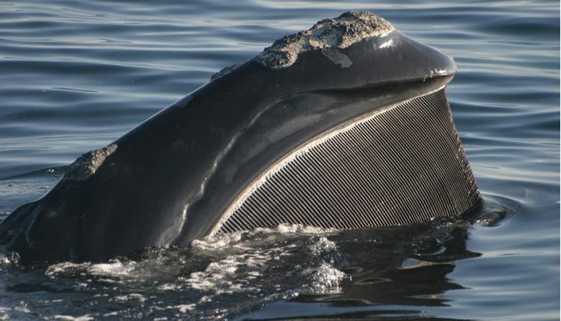

Slide 22
Toothless Whales
Largest animals to ever live on earth
11 species
Overhunting has caused them to almost be extinct (blue, minke, fin, humpback, right, bowhead and gray whales)
Some also eat fish
Some eat on top of water, others are bottom feeders

Slide 23
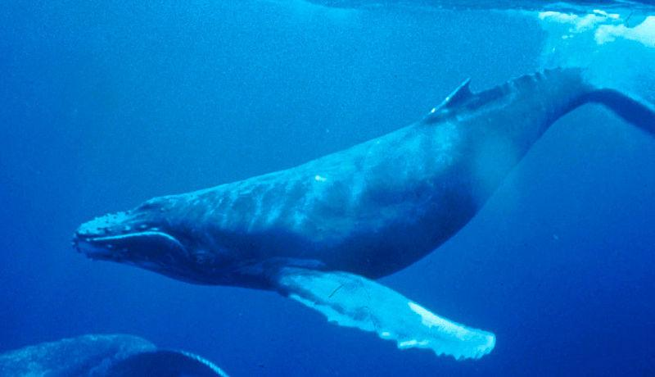
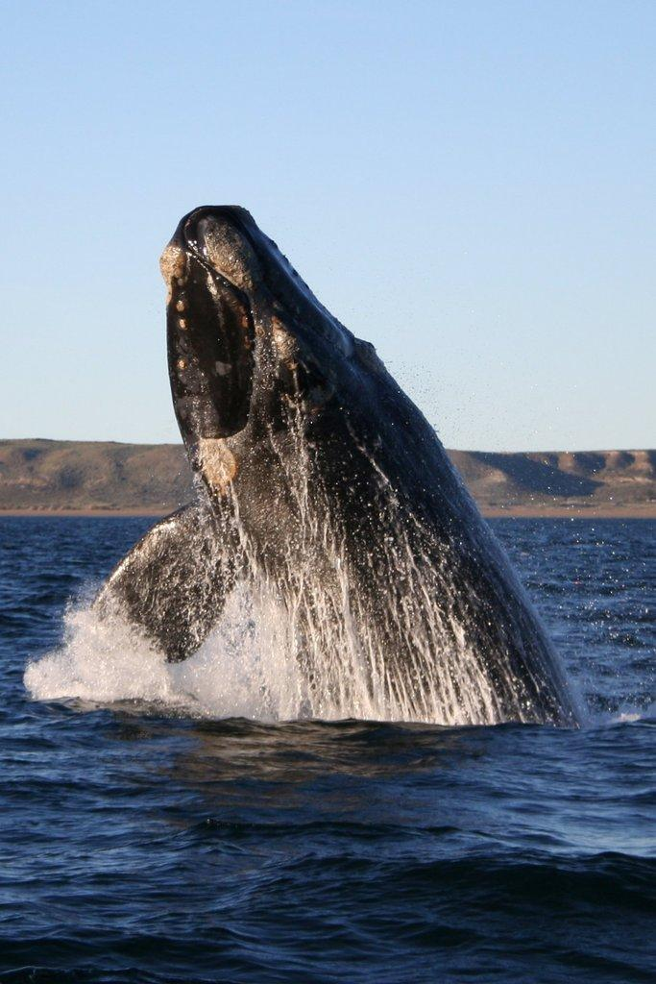
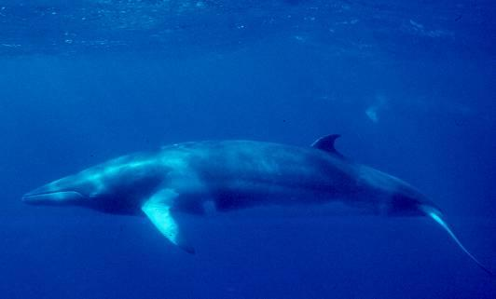
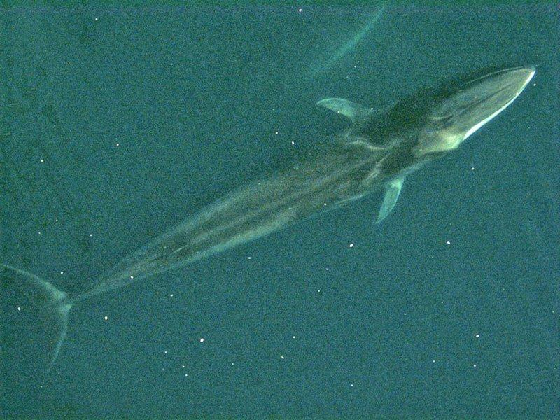

Slide 24
Toothed Whales
Don’t use teeth to chew, just hold onto prey and swallow it whole
3 chambered stomach grinds up food
one blowhole (baleen whales have 2)
  Baleen whales are HUGE and must be able to take in more oxygen than toothed whales which are smaller (in comparison) and need less oxygen. Baleen whales are able to stay under much longer bc of this

Slide 25
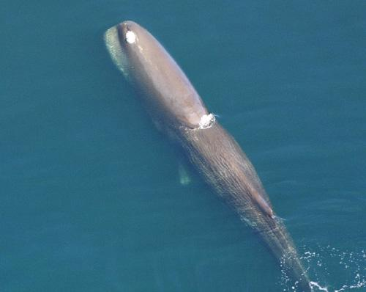
Sperm Whale
Eat squid, fish, and lobsters
Undigested material called ambergris accumulates in the gut
  can be used in perfume
  to flavor food
  as an aphrodisiac
This is the whale from Moby Dick

Slide 26
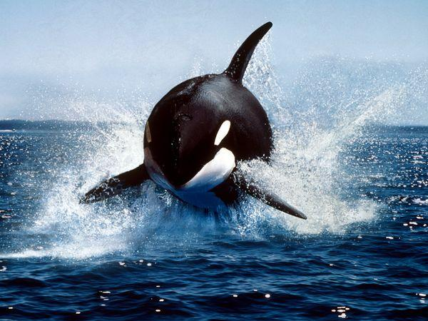
Orcas (Killer whales)
Actually are the largest of the dolphin family
Black and white
Eats penguins, seals, large fish, other small whales

Slide 27
Dolphins & Porpoises
Have distinctive snouts (called a beak)
Seem to be smiling
Playful and social
Easily trained (smart!)
Travel in pods
Dolphins --sharper nose
porpoise--blunter nose

Slide 28
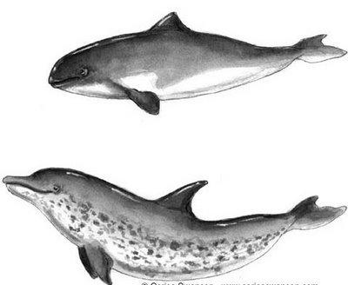
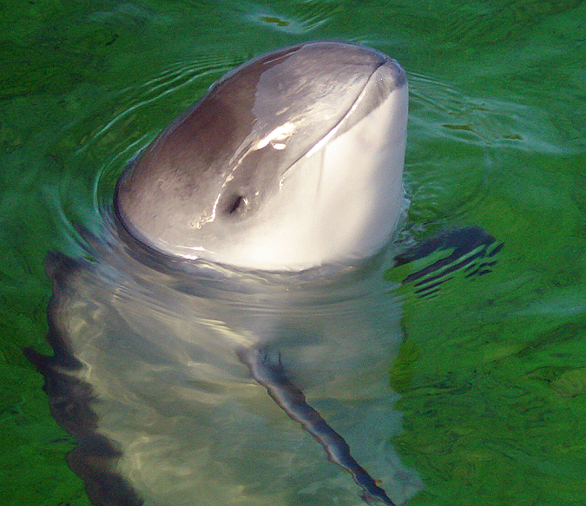
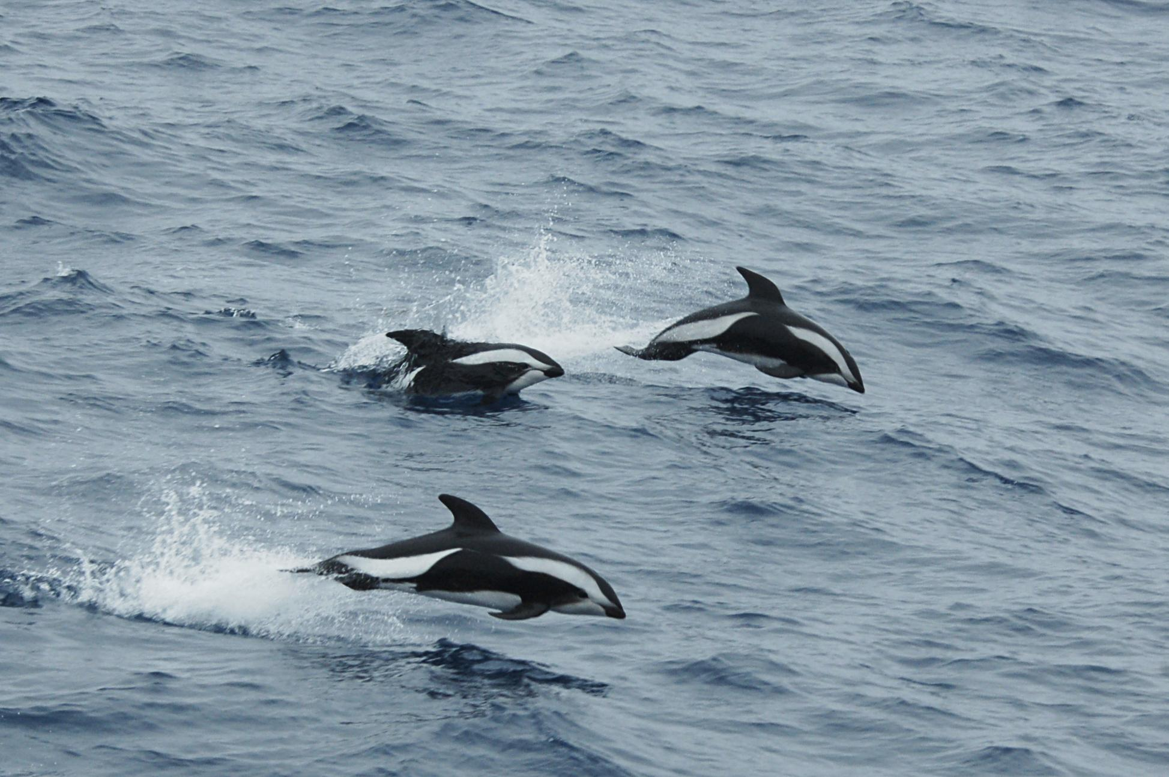

Slide 29
Echolocation
Echolocation is the ability to produce high frequency “clicks” and detect echoes that bounce off distant objects.
This allows marine mammals to “see” their surroundings when there is low light

Slide 30
Echolocation
Marine mammals use sound for:
  Communication
  Exploration
  Locating food
  Identifying individuals within a pod
  Maintaining mother-pup interactions

Slide 31
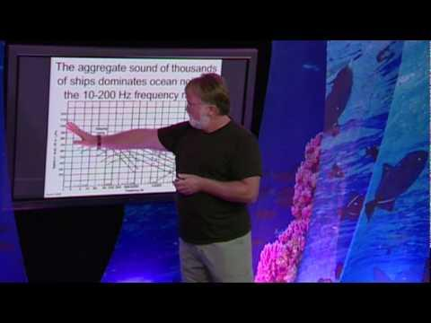
Echolocation-TED talks

Slide 32
Migration & Reproduction
Pinnipeds (Seals, Sea Lions, Walruses) and Whales/Dolphins migrate huge distances every season to their breeding grounds or birthing grounds.
This often coincides with changes in the availability of food for the adults and young.

Slide 33
Migration & Reproduction
Humpback whales have the longest migratory route of any marine mammal species, traveling an average of 5100 miles each way from the warm, tropical waters of Central America to polar waters.

Slide 34
Migration & Reproduction
Humpbacks only feed in the summer in polar waters building up their fat reserves.
They migrate to tropical waters to breed and give birth during the winter (warm waters are “easier” on the baby).
During the entire winter humpbacks don’t eat and just live off of their fat reserves

Slide 35
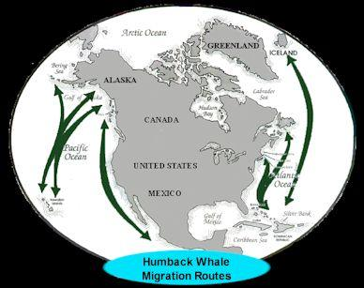

Slide 36
Feeding Techniques
Whales & Dolphins, when hunting, will often act like packs of wolves or prides of lions and work together to catch their prey.
They have developed a couple of different strategies in order to herd their prey into a small area or “corner” their prey
  Ex: Bubble nets or mud nets

Slide 37
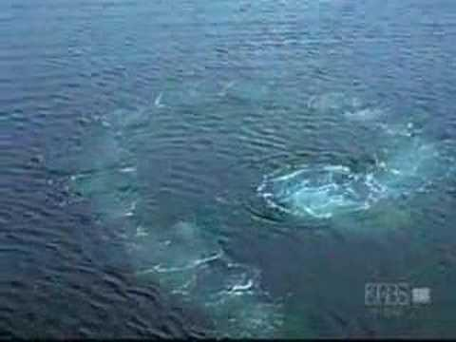
Bubble Nets (Humpback Whale)

Slide 38
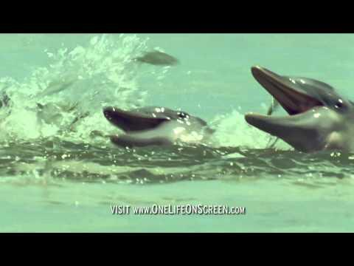
Mud nets (Dolphin)

Slide 39
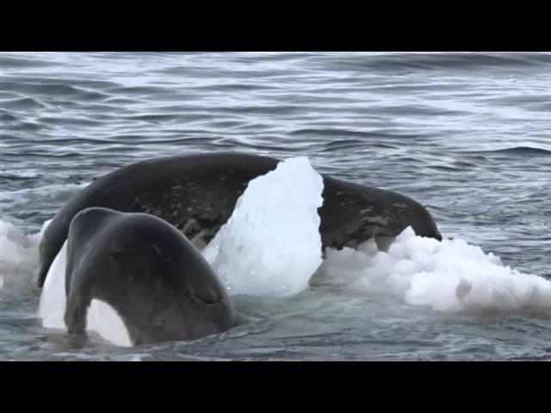
Cornering their prey (Orcas)

Slide 40
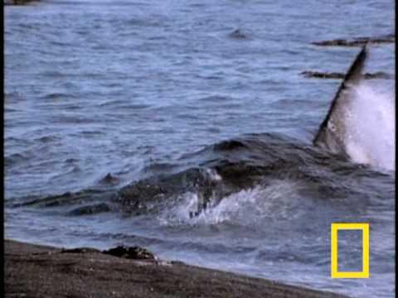
Some work solo...

